Slide 1
Lizards of South America

Slide 2
Lizards of South America
South America is home to a diverse range of lizard species, each with its unique characteristics and adaptations to the various habitats found across the continent. This research explores the fascinating world of South American lizards, highlighting the unique characteristics, habitats, and ecological significance of three remarkable species.

Slide 3
Lizards of South America
The diverse lizard families of South America include geckos, anoles, and perching lizards, each contributing to the continent's rich biodiversity. Notable species include the Green Iguana, Redfooted Tortoise, and Amazonian Water Lizard.

Slide 4
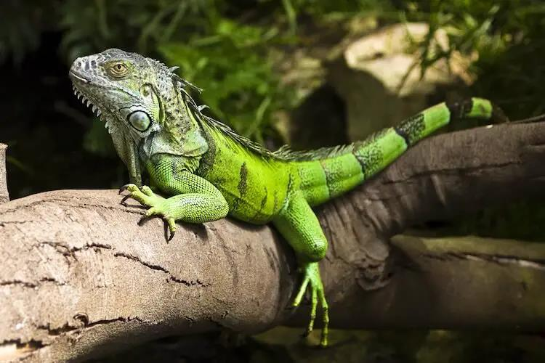

Slide 5
South American Lizards
The Caiman Lizard (Dracaena guianensis) is a captivating reptile native to the tropical regions of South America, particularly found in the Amazon Basin and its surrounding areas. The Tepui Lizard (Pristidactylus urichi) is a captivating and unique reptile inhabiting the Tepui plateaus of South America.

Slide 6
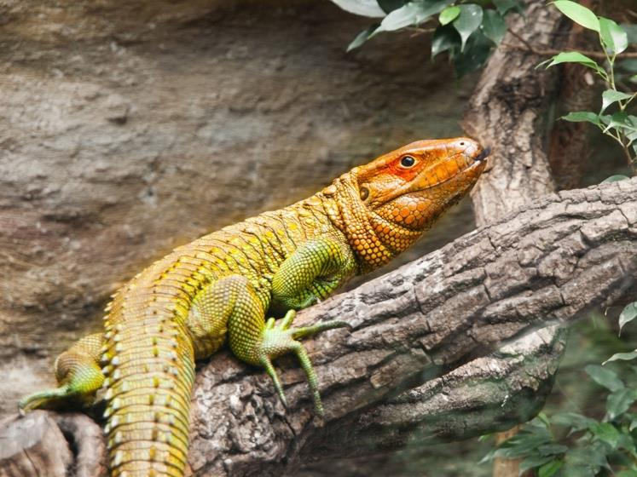

Slide 7
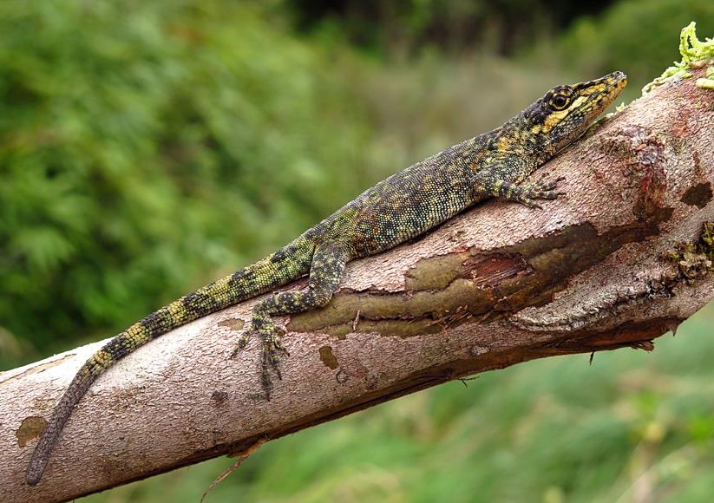

Slide 8
South American Lizards
South American lizards, including the Green Iguana, Caiman Lizard, and Tepui Lizard, are fascinating creatures that contribute to the continent's rich biodiversity. However, they face various threats, and conservation efforts are necessary to ensure their longterm protection.

Slide 9
South American Lizards
South America is home to an impressive diversity of lizards, ranging from small geckolike creatures to large monitor lizards. These reptiles play vital roles in their respective ecosystems, maintaining the delicate balance of nature. However, they face numerous threats, such as habitat loss, climate change, and illegal trade, which necessitate urgent conservation efforts.

